Slide 1
Uddingston
Hockey Club
Player Pathways

Slide 2
Youth Hockey
Primary Youth
Monday & Wednesday
Session 1: 5.45pm - 6.30pm
Session 2: 6.45pm - 7.30pm
Secondary Youth
Tuesday & Thursday
5.45pm - 7pm

Slide 3
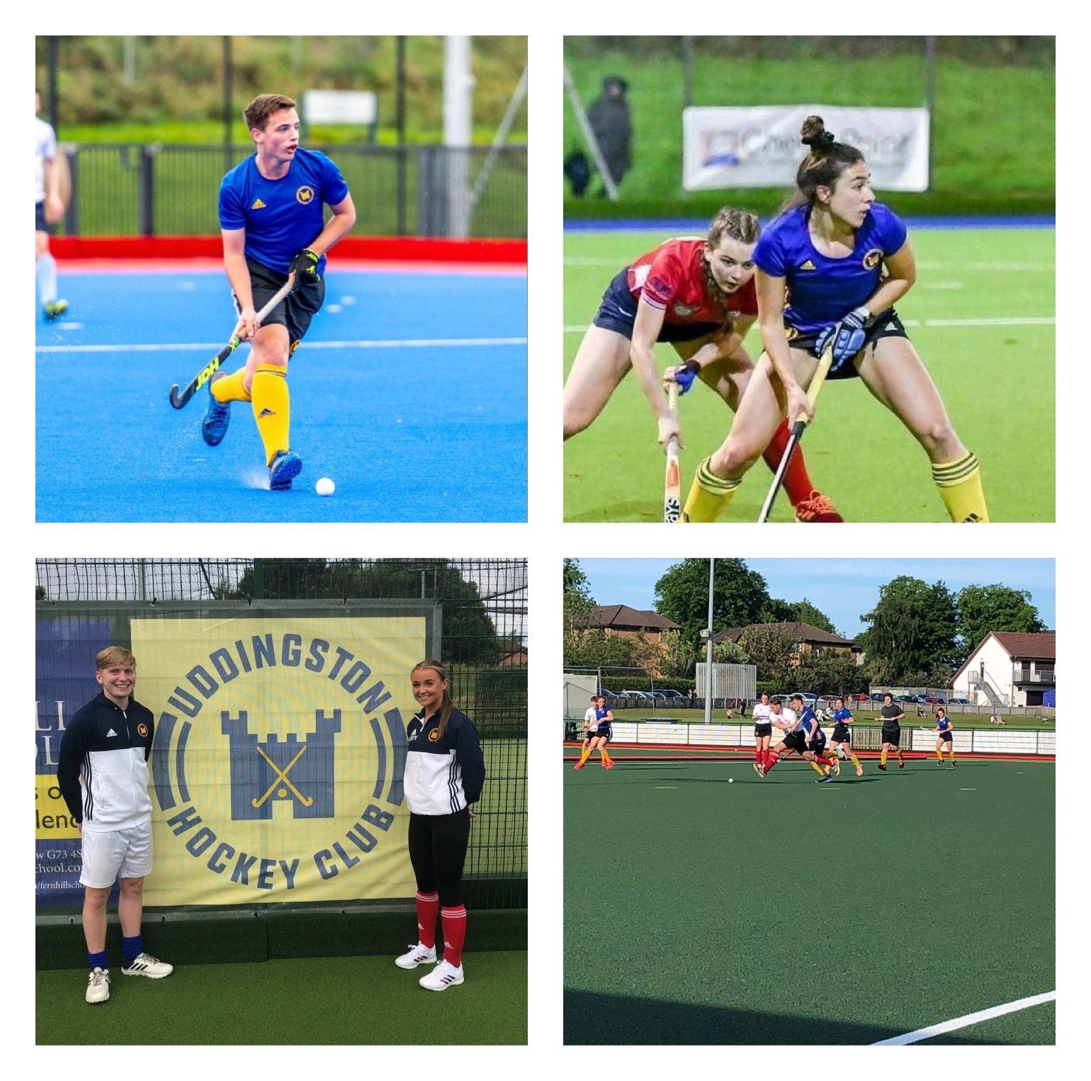
Senior Hockey
Ladies 4’s
(Social & Domestic)
Gents 5’s (Social & Domestic)
Ladies 3’s (Invite)
Gents 4’s (Social & Domestic)
Ladies 2’s (Invite)
Gents 3’s (Invite)
Ladies 1’s (Invite)
Gents 2’s (Invite)
Gents 1’s (Invite)

Slide 4
Performance Pathway
Introductory Senior Gents 4’s
Senior
Gents 1’s
Youth Hockey
Performance Boys / Girls Training
Introductory Senior Ladies 4’s
Senior Ladies 1’s
Performance Hockey
Individual’s who demonstrate performance indicators are invited by special request to performance youth training from youth coaches, hosted by Director of Hockey and Performance Coach – Harry Dunlop.
For the last half an hour of the sessions the performance youth can train with Uddingston Hockey Performance teams (1’s) tor provide a smooth transition into performance hockey, when the time is right.
Players demonstrating ability are selected into a non standard pathway subsequently invited to play in higher senior teams. The pathway begins in a developmental team; Senior Ladies and Gents 4’s teams and quickly escalates directly to the senior 1’s team.
Whilst in the performance team, players are encouraged to progress their hockey career with the West District, Scottish Hockey and Great Britain.

